Slide 1
Prediction of Policyholders’ Interests on Cross-Sell Product -- Vehicle Insurance
Wenxiao Zhou, Yuxin Tang, Jiayi Zhou, Yisha Zhou

Slide 2

Overviews
Background Introduction
Data characteristics
EDA Analysis
Modeling and Algorithm
Imbalance Problem and SMOTE
Logistics Regression Model
Random Forest
Target Customer Analysis
Data Clustering
Summary and Conclusion

Slide 3
Background
Insurance is a way of managing risks which protects against the financial risks that are present at all stages of people’s likes and businesses.
In this paper, the problem we considered is an Insurance company that has provided Health Insurance to its customers now they need your help in building a model to predict whether the policyholders from past year will also be interested in Vehicle Insurance provided by the company.

Slide 4
Background
Motivation
Health insurance policyholders whether also interested in the new insurance
Find the most valued customers and summarize the characteristics of target customers
Main Goal
Construct the Logistic Regression model for whether a customer is interested in auto insurance
Through Data Clustering to detect the most valued customers and summarize the characteristics of target customers.

Slide 5
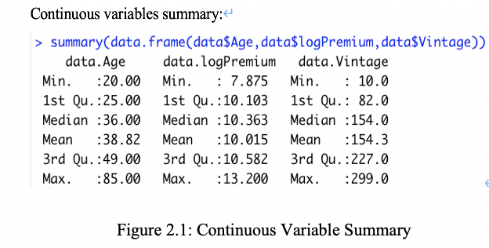
Data Characteristics
Information about demographics, vehicle and policy which includes 12 variables
Continuous variables: customer age, annual premium and vintage
Categorical variables:gender and previously insured or not,vehicle age...
Response variable = 1 if the customer is interested, and 0 otherwise
Note: Use abbreviation for variables: ID, Gender, Age, Drive, Code, Insured, Vage, Damage, Premium, Channel, Vintage, y.

Slide 6
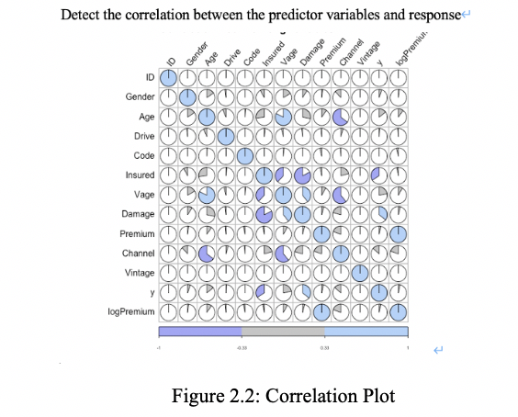
EDA Analysis
Age and Vage: High positive correlation
Insured and Damage: High negative correlation

Slide 7
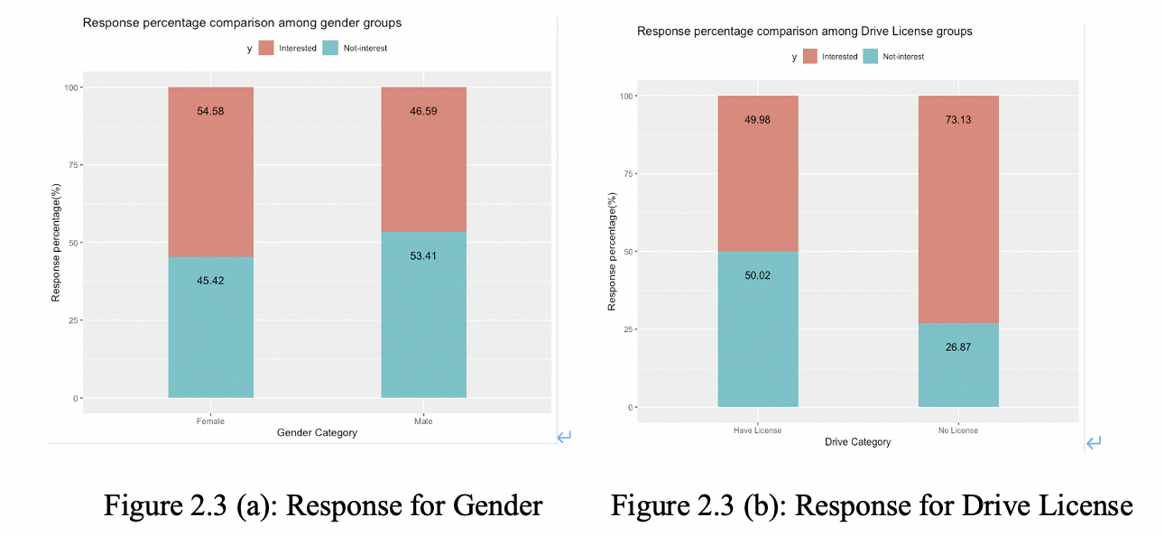
EDA Analysis
The distributions of interests in insurance among gender groups are similar
The distributions of interests in insurance Drive License groups shows significant differences among groups
Focus on the effect of Driver License to response in the following analyses.

Slide 8
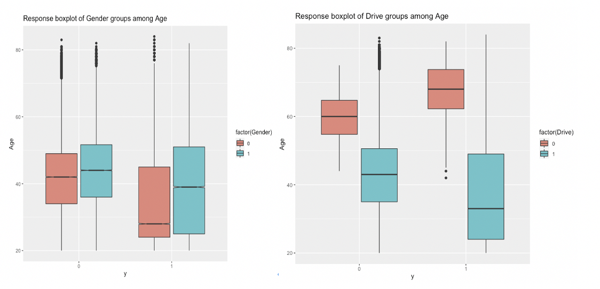
EDA Analysis
No significant intersection between Gender and Age
there is a significant intersection between Drive and Age

Slide 9
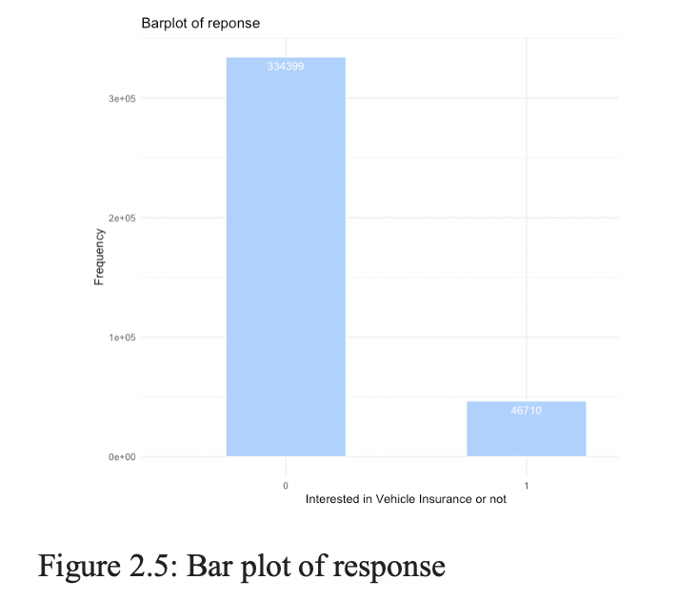
Imbalance Problem
Responses are not represented equally
The percentage of interested is approximately 12.3 and the percentage of not interested is 87.7
Using SMOTE algorithm to solve the imbalance problem

Slide 10
General Imbalanced Problem Solving
Undersampling:
reduces the number of observations of the large categories to balance the data set. This method is more suitable when the overall data set is large.
Oversampling:
deals with small classes. It balances the data by repeating the observations of small classes. This method is also called Upsampling.
Synthetic Data Generation:
use the generation of artificial data instead of repeating the original observation to solve the imbalance. It is also an oversampling technique
Cost Sensitive Learning: To solve the imbalance problem by measuring the cost of misclassified observations

Slide 11
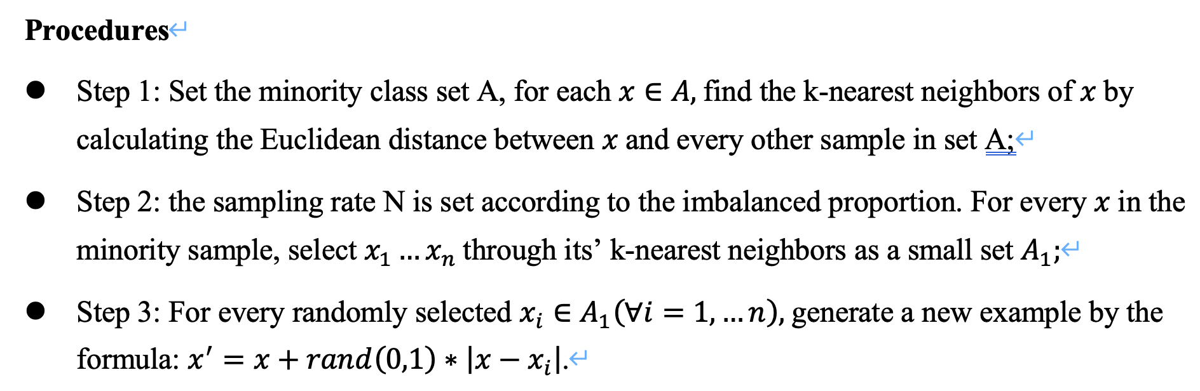
SMOTE Algorithm
SMOTE (synthetic minority oversampling technique) is used to solving imbalance problem by synthetic data generation. It is an improved method basing on random sampling, which adopts a strategy of simply copying samples to increase minority samples, is not prone to the problem of model overfitting.

Slide 12
SMOTE Algorithm
Use DMwR::SMOTE function in R: the the average number of generating minority class sample is 1, we use 5-nearest neighbors when using over-sampling, and for majority class, we choose 2N/100 samples corresponding to the minority
After applying the algorithm, we have the samples in train groups with response = 0 and response = 1 are 74703 and 74736 respectively, which can be considered as a balanced dataset.

Slide 13
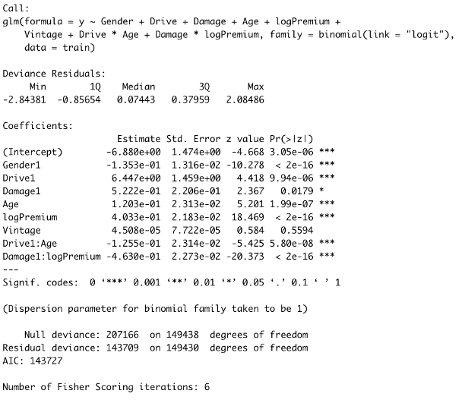
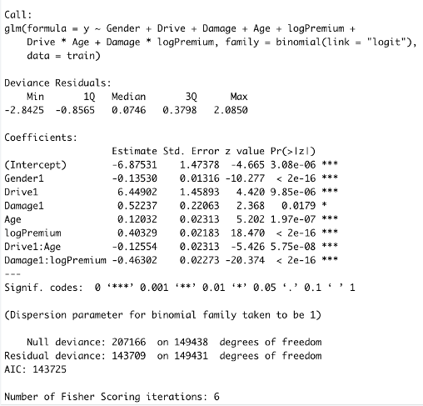
Logistics Regression Model

Slide 14
Logistics Regression Model
Categorical Predictors
Customer with driver license is highly interested
Customer got car damaged is highly interested
Female customers having more interests than males
Focus on investigating people who do not have insured in any vehicle insurance
Continuous Predictors
The influence of one-unit increase in LogPremium is larger than Age increase
Pay less attention to Vintage for future study
The more the customer needs to pay as premium for health insurance, the more interest they have for the new vehicle insurance

Slide 15
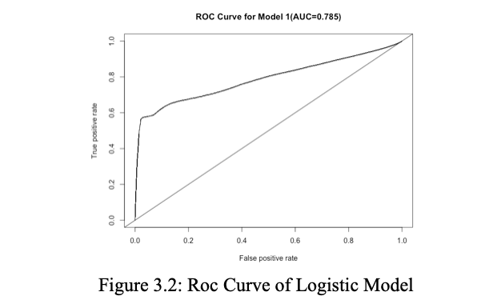
Logistics Regression Model

Slide 16
Random Forest
Random forest is an ensemble learning method of classification by generating bootstrap samples from the training data
Balanced random forest algorithm (Chao Chen et al., 2004) is used to ensemble trees induced from balanced down-sampled data without data loss:
(1) A large number of bootstrap samples are taken from the training data and create separate unpruned tree for each set;
(2) Randomly samples a subset of predictors at each split to encourage diversity of the resulting trees.
(3) Combining all the prediction results in every tree to generate a single prediction for an individual sample.
To incorporate down-sampling, random forest can take a random sample of size c*nmin, where c is the number of classes and nmin is the number of samples in the minority class.

Slide 17
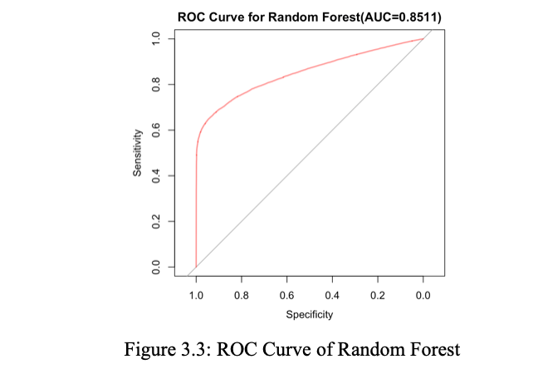
Random Forest

Slide 18
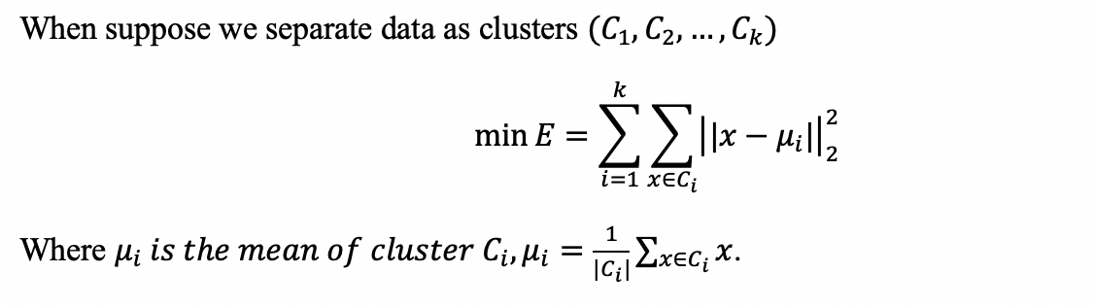
Target Customer Analysis
Apply the centroid-based clustering algorithm method --- K-Means clustering, which can organize the data into non-hierarchical clusters
Perform resampling method again to take a random sample from the data with size 10000 to perform the algorithm.

Slide 19
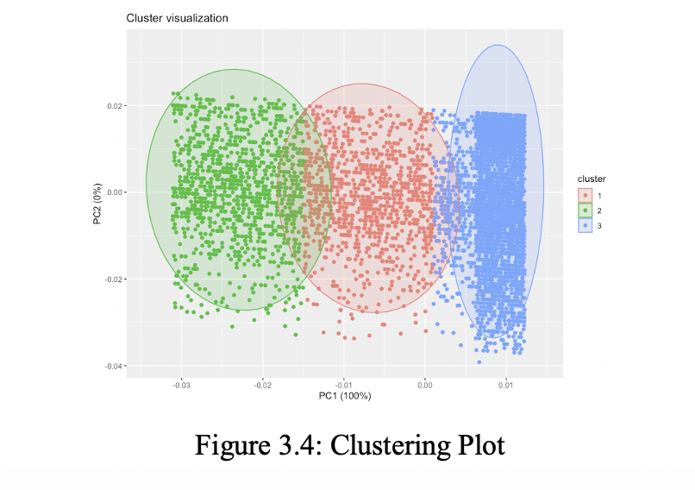
Target Customer Analysis
Cluster 2 and Cluster 3 are significantly different
Cluster 1 is the potential customer group
After combining the Cluster 1 and 2 as one cluster with Cluster 3 as one cluster, we can detect the differences between these two groups.

Slide 20
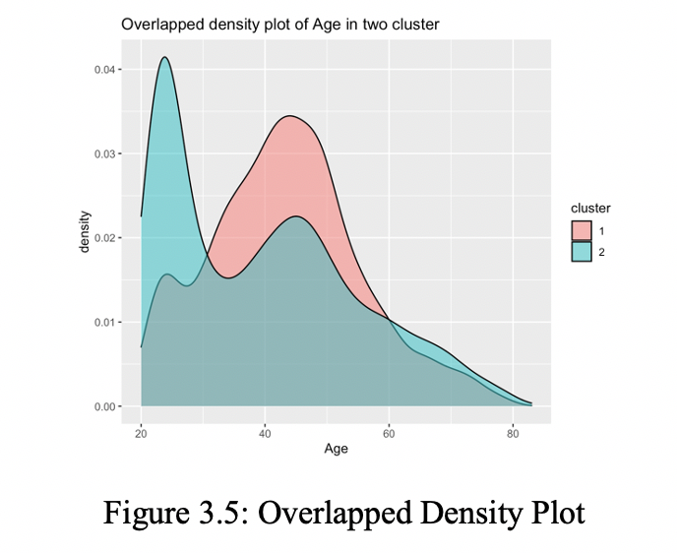
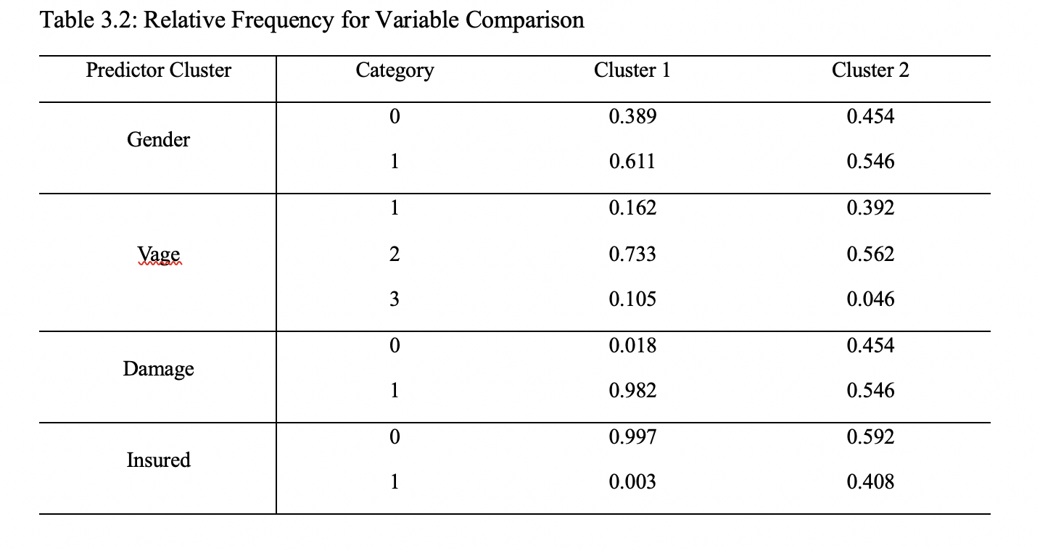
Target Customer Analysis
Figure 3.5: Potential customers are corresponding to ones are most among age of 40-60 years old
Table 3.2: Some distinct features with our potential customers: the vehicle age is 1 - 2 years; the car got damaged in the past; the customers do not have the vehicle insurance

Slide 21

Summary and Conclusion
Logistic Regression Model: The “best” fitted model is with predictors Gender, Drive, Damage, Age, LogPremium, Drive*Age, Damage*LogPremium. AUC = 0.785.
Balanced Random Forest algorithm is is used to ensemble trees induced from balanced down-sampled data without data loss. Improve the accuracy --- AUC = 0.8511.

Slide 22
Summary and Conclusion
Consider the cars --- potential customers are those with drive license, and got car damaged. Investigating with people who do not have insured in any vehicle insurance will be more effective.
Consider the basic information of customers --- female customers show higher interest than males. It’s shown that customers age within 40-60 are more likely to interested in the insurance than the age within 20-30.
For clients have enrolled for a long period, we should focus on the ones who pay high premium every year. Since these clients have long period enrolling in the company, they have confidence with the company and are more willing to try new insurance projects.

Slide 23
THANK YOU

